Slide 1
Name: list
Purpose: Linked list
Usage: list<int> x; x.push_back(5);
Inserting an item (top, middle*, or bottom): O(1)
Deleting an item (top, middle*, or bottom): O(1)
Accessing an item (top or bottom): O(1)
Accessing an item (middle): O(n)
Finding an item: O(n)
*But to get to the middle, you may have to
first iterate through X items, at cost O(x)
Name: set
Purpose: Maintains a set of unique items
Usage: set<string> s; s.insert(“Ack!”);
Inserting a new item: O(log₂n)
Finding an item: O(log₂n)
Deleting an item: O(log₂n)
Name: queue and stack
Purpose: Classic stack/queue
Usage: queue<long> q; q.push(5);
Inserting a new item: O(1)
Popping an item: O(1)
Examining the top: O(1)
Name: vector
Purpose: A resizable array
Usage: vector<int> v; v.push_back(42);
Inserting an item (top, or middle): O(n)
Inserting an item (bottom): O(1)
Deleting an item (top, or middle): O(n)
Deleting an item (bottom): O(1)
Accessing an item (top, middle, or bottom): O(1)
Finding an item: O(n)
Name: map
Purpose: Maps one item to another
Usage: map<int,string> m; m[10] = “Bill”;
Inserting a new item: O(log₂n)
Finding an item: O(log₂n)
Deleting an item: O(log₂n)

Slide 2
The Selection Sort
The Insertion Sort
And here’s the C++ version which sorts an array in ascending order!
void insertionSort(int A[], int n)
{
for(int s = 2; s <= n; s++)
{
int sortMe = A[ s - 1 ];
int i = s - 2;
while (i >= 0 && sortMe < A[i])
{
A[i+1] = A[i];
--i;
}
A[i+1] = sortMe;
}
}
Focus on successively larger prefixes of the array. Start with the first s=2 elements, then the first s=3 elements...
And here’s the C++ source code to sort a bunch of numbers…
Make a copy of the last val in the current set – this opens up a slot in the array for us to shift items!
void selectionSort(int A[], int n)
{
for (int i = 0; i < n; i++)
{
int minIndex = i;
for (int j = i+1; j < n; j++)
{
if (A[j] < A[minIndex])
minIndex = j;
}
swap(A[i], A[minIndex]);
}
}
Shift the values in the focus region right until we find the proper slot for sortMe.
Store the sortMe value into the vacated slot.

Slide 3
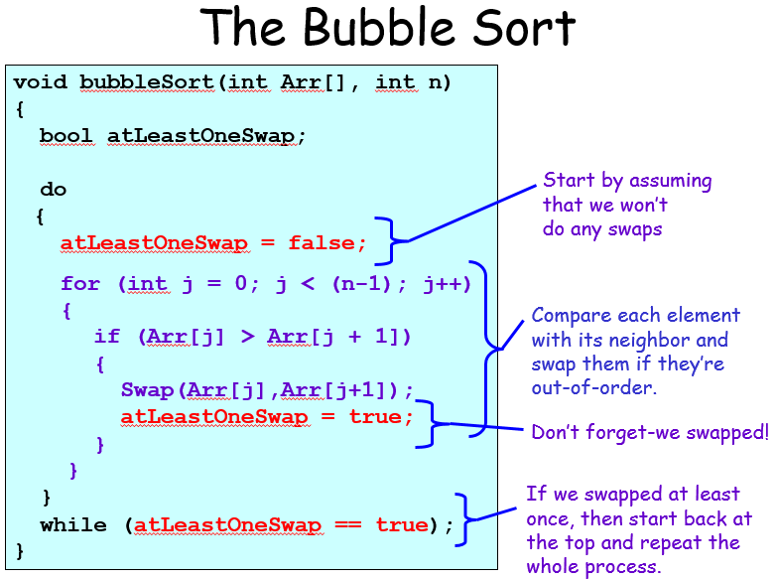
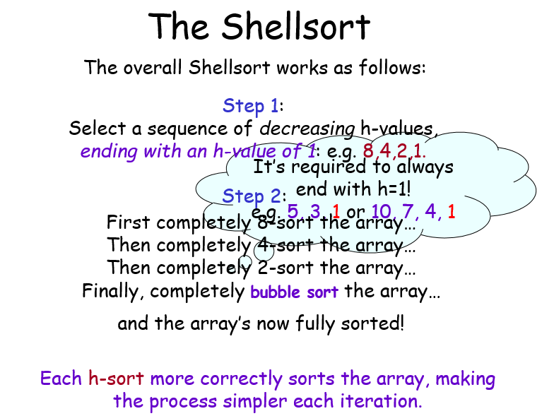

Slide 4
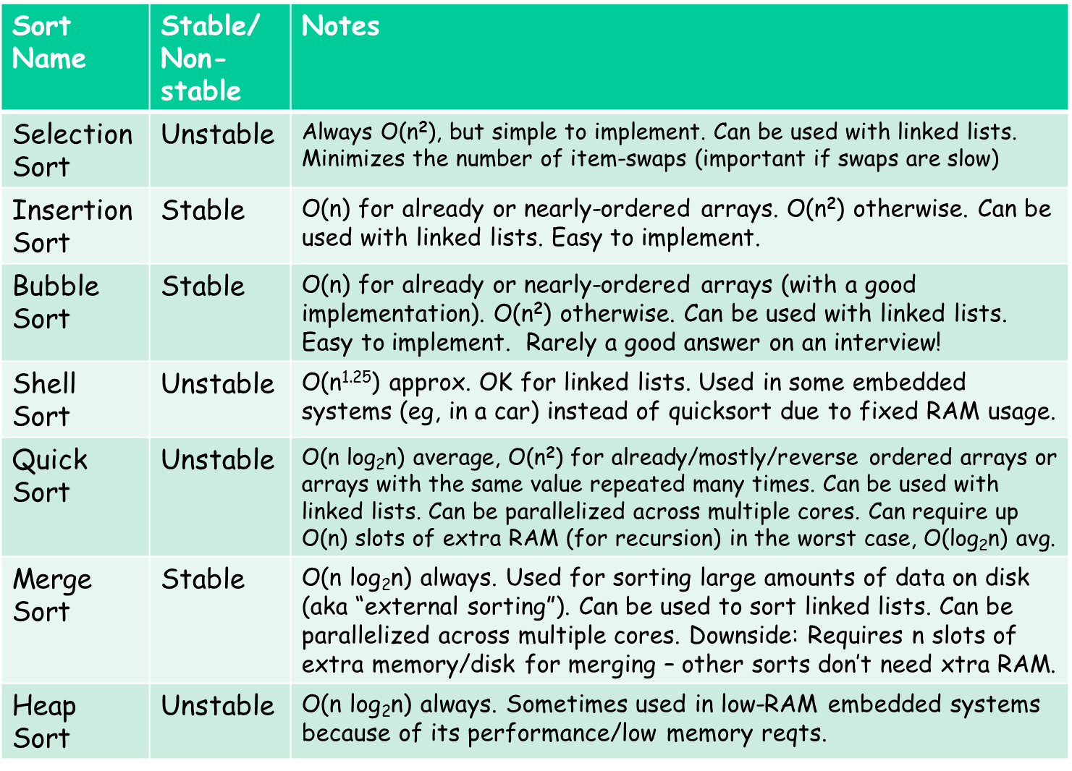

Slide 5
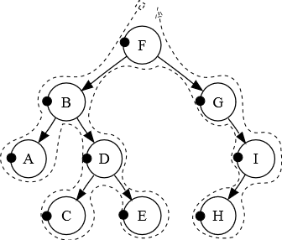
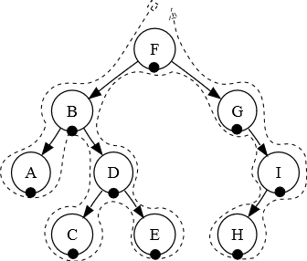
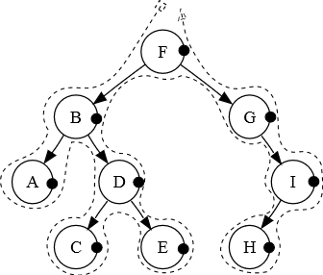
Tree traversal
Searching a BST
Pre-order: F, B, A, D, C, E, G, I, H
Print, left, right
In-order: A, B, C, D, E, F, G, H, I
Left, print, right
Post-order: A, C, E, D, B, H, I, G, F
Left, right, print
bool Search(int V,Node *ptr)
{
while (ptr != NULL)
{
if (V == ptr->value)
return(true);
else if (V < ptr->value)
ptr = ptr->left;
else
ptr = ptr->right;
} return(false); // nope
}
bool Search(int V, Node *ptr)
{
if (ptr == NULL)
return(false); // nope
else if (V == ptr->value)
return(true); // found!!!
else if (V < ptr->value)
return(Search(V,ptr->left));
else
return(Search(V,ptr->right));
}

Slide 6
void insert(const std::string &value)
{
if (m_root == NULL) { m_root = new Node(value); return; }
Node *cur = m_root;
for (;;) {
if (value == cur->value) return;
if (value < cur->value) {
if (cur->left != NULL) cur = cur->left;
else
{
cur->left = new Node(value);
return;
}
}
else if (value > cur->value)
{
if (cur->right != NULL) cur = cur->right;
else
{
cur->right = new Node(value);
return;
}
}
}
}
BST Deletion
Step 1: Searching for value V
parent = NULL
cur = root
While cur != NULL
If V == cur->value, then we’re done.
If (V < cur->value)
parent = cur;
cur = cur->left;
C. Else if (V > cur->value)
parent = cur;
cur = cur->right;

Slide 7
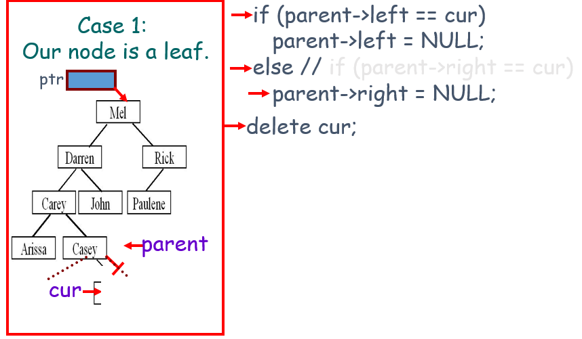
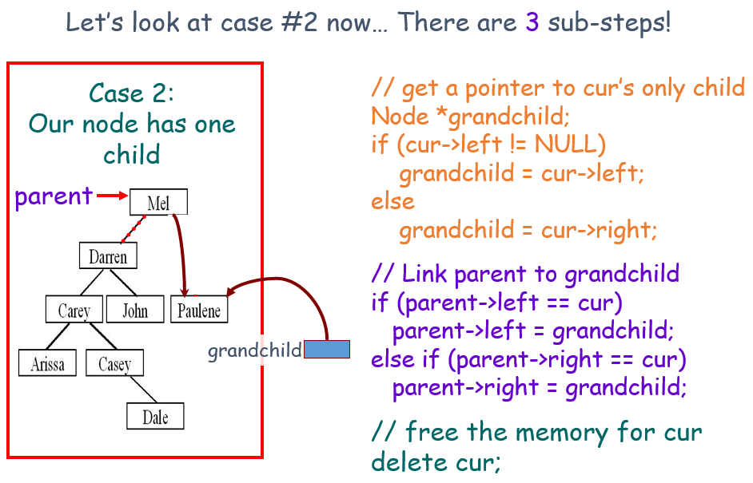
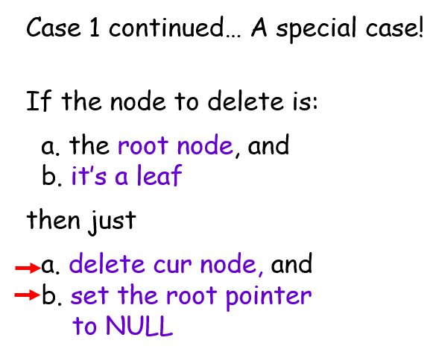
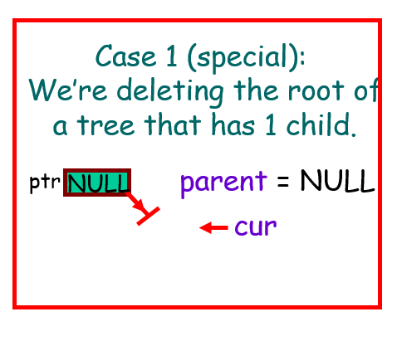

Slide 8
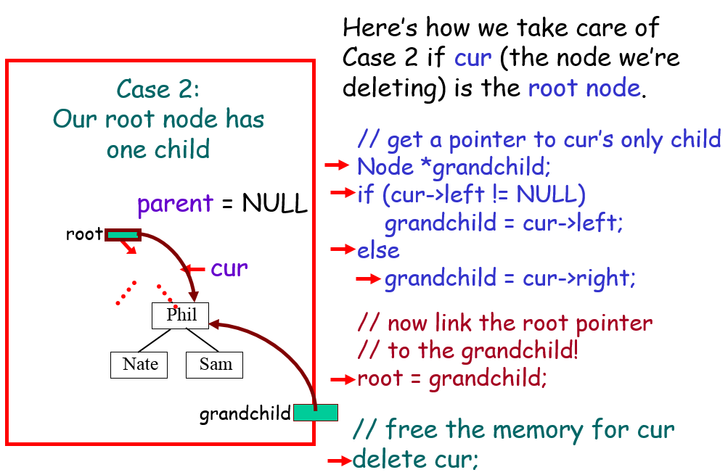
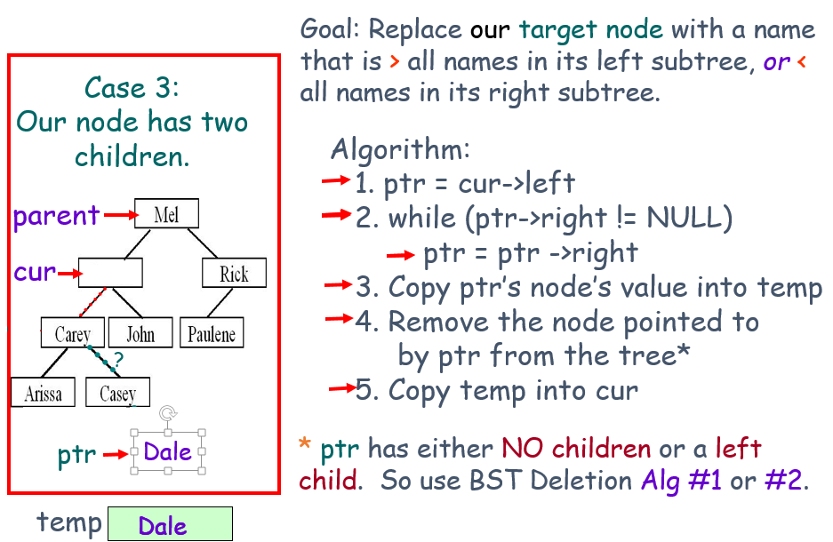
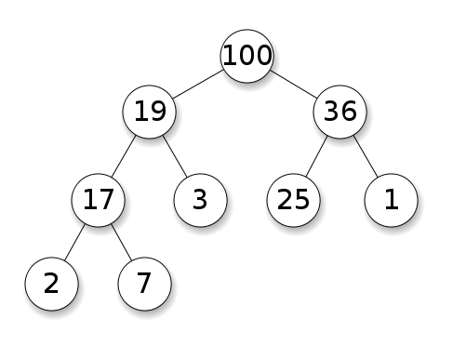
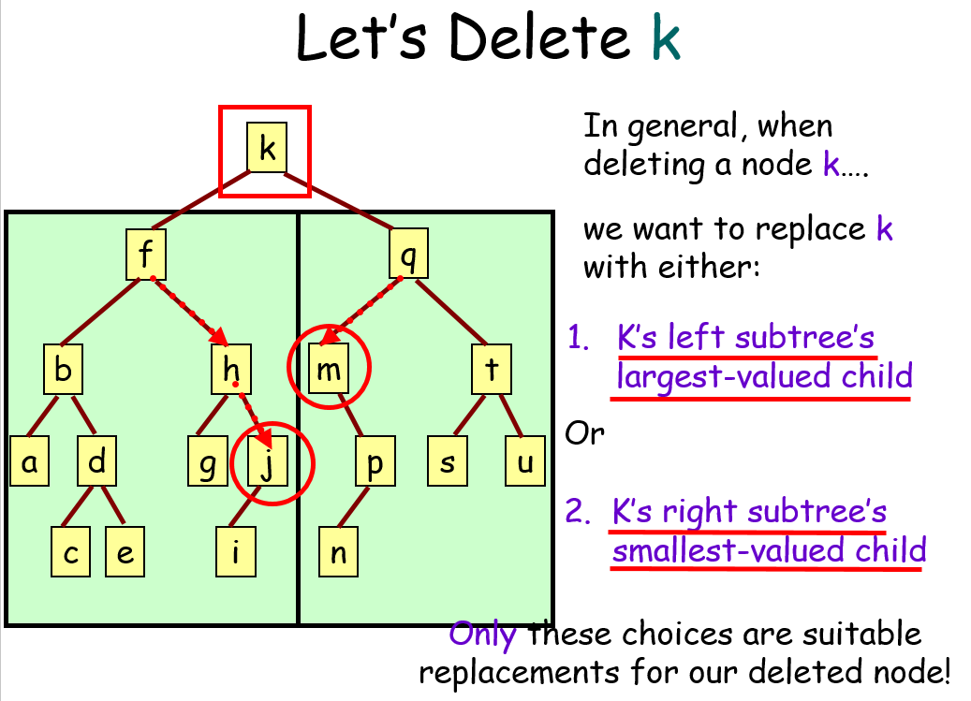
Maxheap

Slide 9
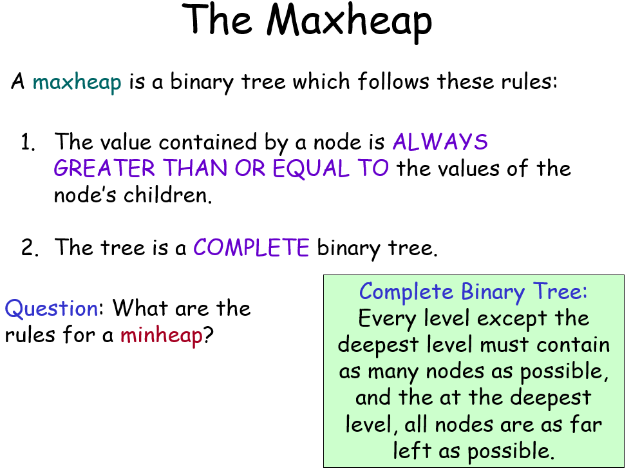
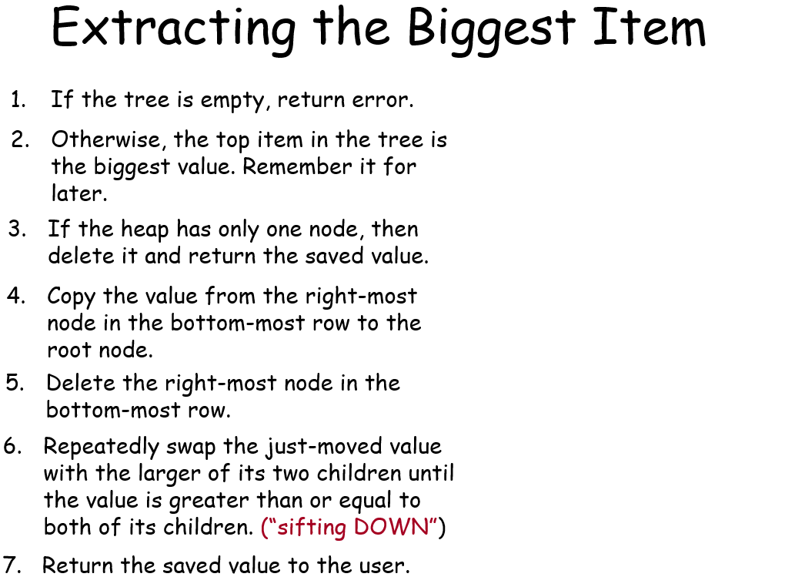
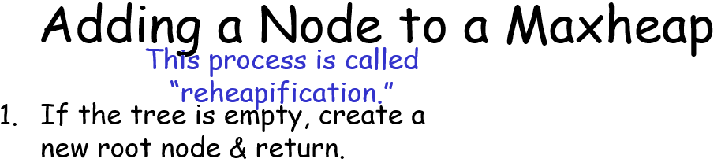
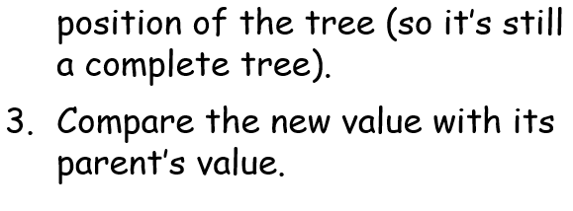
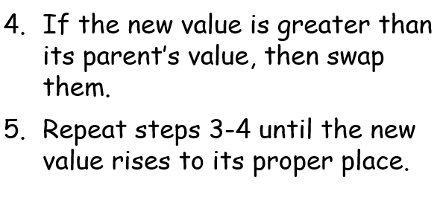
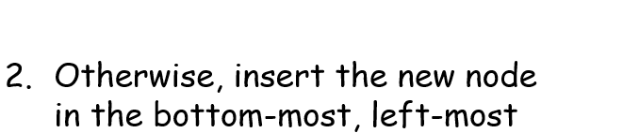

Slide 10
Array based heap: int count; int heap[1000];
The root of the heap goes in array[0]
If the data for a node appears in array[i], its children, if they exist, are in these locations:
Left child: array[2i+1]
Right child: array[2i+2]
If the data for a non-root node is in array[i], then its parent is always at array[(i-1)/2] (Use integer division)
We can always find the root value in heap[0]
We can always find bottom-most, right-most node in heap[count-1]
We can always find the bottom-most, left-most empty spot (to add a new value) in heap[count]
We can add or remove a node by simply setting heap[count] = value; and/or updating our count!
Copy the value from the right-most, bottom-most node to the root node: heap[0] = heap[count-1]
Extracting from a Maxheap – The Array Version!
If the count == 0 (it’s an empty tree), return error.
Otherwise, heap[0] holds the biggest value. Remember it for later.
Delete the right-most node in the bottom-most row: count = count - 1
Repeatedly swap the just-moved value with the larger of its two children: Starting with i=0, compare and swap: heap[i] with heap[2*i+1] and heap[2*i+2]
If the count == 1 (that was the only node) then set count=0 and return the saved value.
7. Return the saved value to the user.

Slide 11
Adding a Node to a Maxheap – The Array Version
The Efficient (Official) Heapsort
Insert a new node in the bottom-most, left-most open slot: heap[count] = value
count = count + 1;
Given an array of N numbers that we want to sort:
1. Convert our input array into a new maxheap
2. While there are numbers left in the heap:
A. Remove the biggest value from the heap
B. Place it in the last open slot of the array
Compare the new value heap[i] with its parent’s value: heap[(i-1)/2]
If the new value is greater than its parent’s value, then swap them.
Repeat steps 2-3 until the new value rises to its proper place or we reach the top of the array.
Reheapification Algorithm (same as before)
Copy the value from the right-most node in the bottom-most row to the root node.
Delete the right-most node in the bottom-most row.
Repeatedly swap the just-moved value with the larger of its two children until the value is greater than or equal to both of its children.
startNode = N/2 - 1
Ok, now here’s the algorithm for step 1 of Heapsort:
for (curNode = startNode thru rootNode):
Focus on the subtree rooted at curNode.
Think of this subtree as a maxheap.
Keep shifting the top value down until your subtree becomes a valid maxheap.

Slide 12
To templatize a non-class function called bar:
Update the function header: int bar(int a) → template <typename ItemType> ItemType bar(ItemType a);
Replace appropriate types in the function to the new ItemType: { int a; float b; … } → {ItemType a; float b; …}
To templatize a class called foo:
Put this in front of the class declaration: class foo { … }; → template <typename ItemType> class foo { … };
Update appropriate types in the class top the new ItemType
How to update internally-defined methods:
For normal methods, just update all types to ItemType: int bar(int a) { … } → ItemType bar(ItemType a) { … }
Assignment operator: foo &operator=(const foo &other) → foo<ItemType>& operator=(const foo<ItemType>& other)
Copy constructor: foo(const foo &other) → foo(const foo<ItemType> &other)
For each externally defined method:
For non inline methods: int foo::bar(int a) → template <typename ItemType> ItemType foo<ItemType>::bar(ItemType a)
For inline methods: inline int foo::bar(int a) → template <typename ItemType> inline ItemType foo<ItemType>::bar(ItemType a)
For copy constructors and assignment operators
foo &foo::operator=(const foo &other) → foo<ItemType>& foo<ItemType>::operator=(const foo<ItemType>& other)
foo::foo(const foo &other) → foo<ItemType>::foo(const foo<ItemType> &other)
If you have an internally defined struct blah in a class: class foo { … struct blah { int val; }; … };
Simply replace appropriate internal variables in your struct (e.g., int val;) with your ItemType (e.g., ItemType val;)
If an internal method in a class is trying to return an internal struct (or a pointer to an internal struct):
You don’t need to change the function’s declaration at all inside the class declaration; just update variables to your ItemType
If an externally-defined method in a class is trying to return an internal struct (or a pointer to an internal struct):
Assuming your internal structure is called “blah”, update your external function bar definitions as follows:
blah foo::bar(…) { … } → template<typename ItemType>typename foo<ItemType>::blah foo<ItemType>::bar(…) { … }
blah *foo::bar(…) { … } → template<typename ItemType>typename foo<ItemType>::blah *foo<ItemType>::bar(…) { … }
Try to pass templated items by const reference if you can (to improve performance):
Bad: template <typename ItemType> void foo(ItemType x)
Good: template <typename ItemType> void foo(const ItemType &x)
Carey’s Template Cheat Sheet

